Slide 1

Adaptive LAtent Distributed Data-processing for Integrative Networks (ALADDIN)
Shakthi Visagan, 804 622 954, Bioengineering student
Z. Towfic
J. Kenanian
ECE 210A: Learning and Adaptation

Slide 2
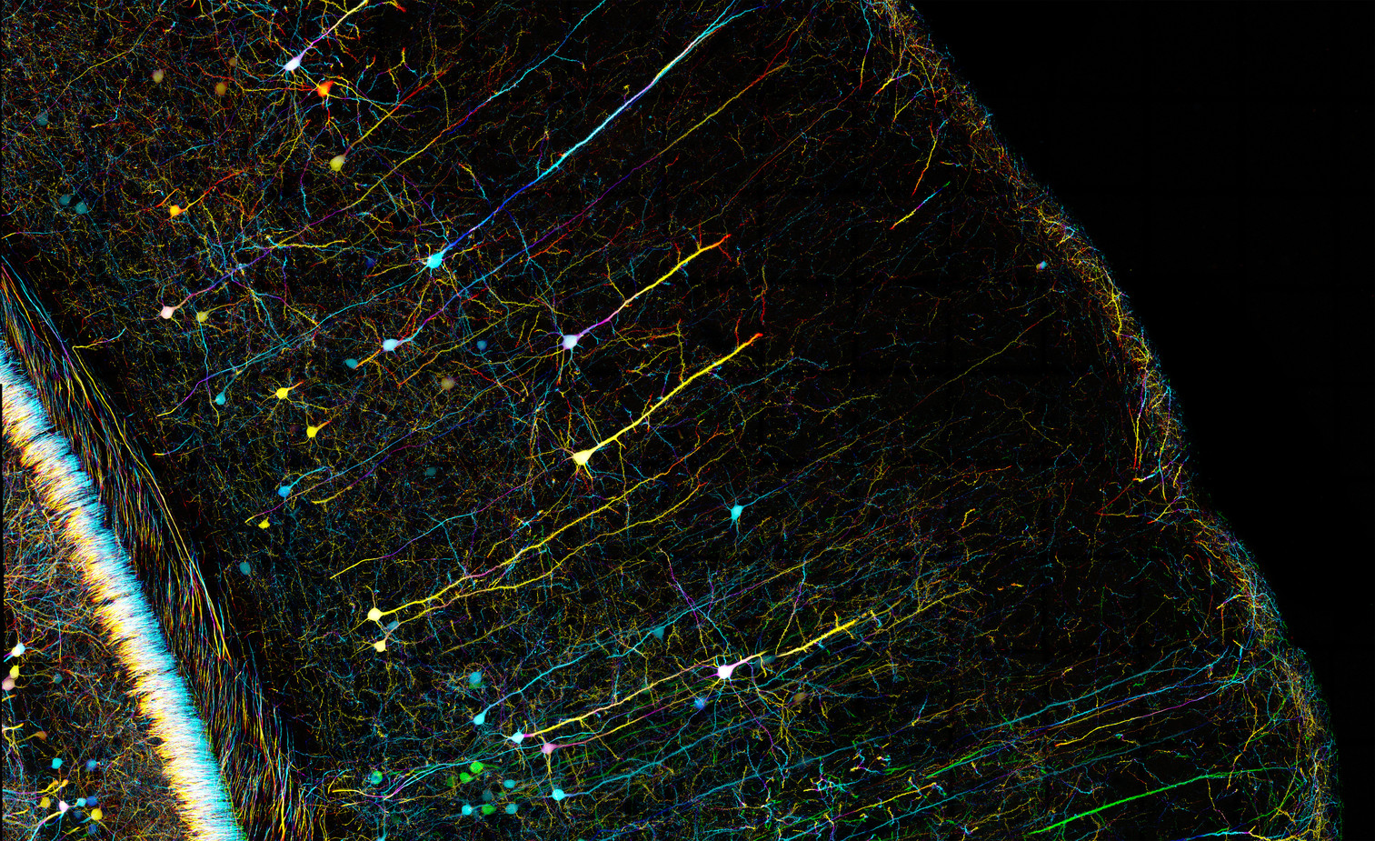

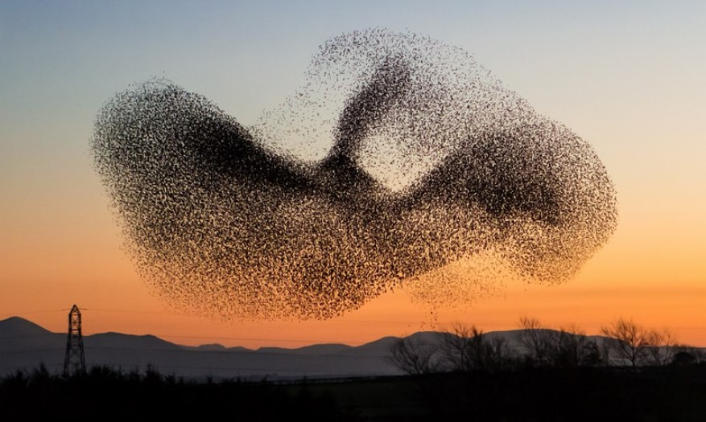
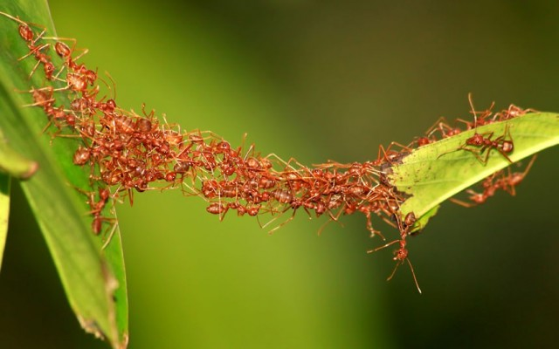
Emergence
Emergence: the whole is greater than the sum of its parts
Complex Adaptive Systems (CAS) display this property
Individual behaviors based off of stochastic environmental variables leads to collective intelligence
Several small unintelligent agents create a larger group that is slightly less unintelligent

Slide 3
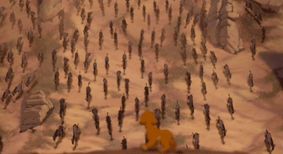
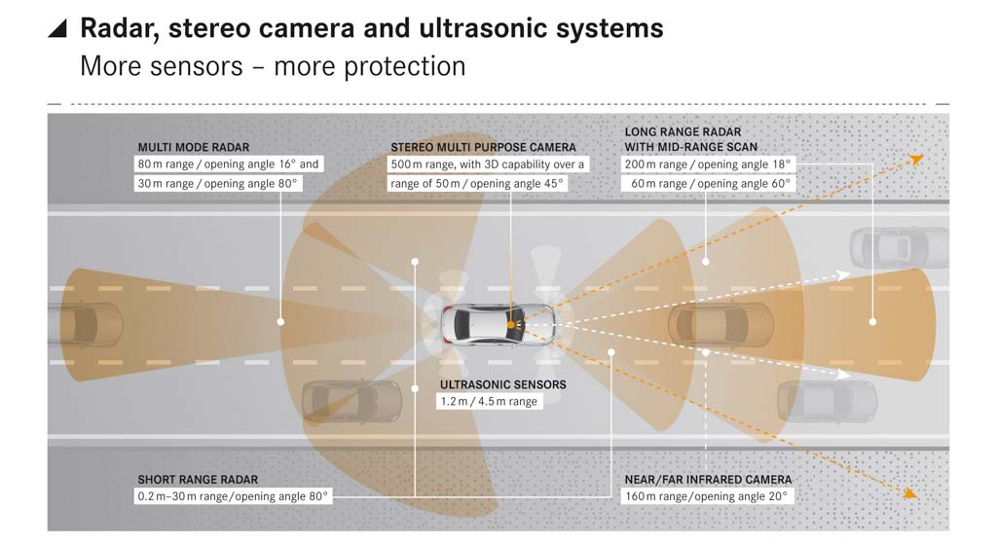
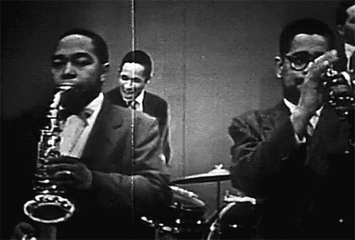
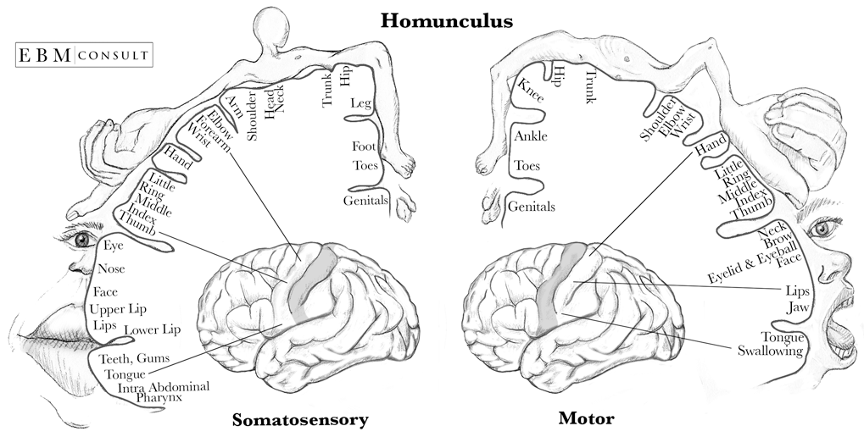

Slide 4

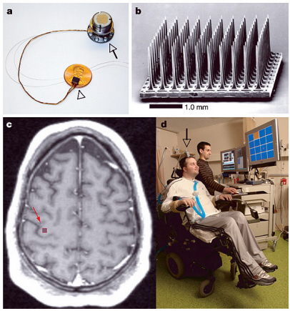
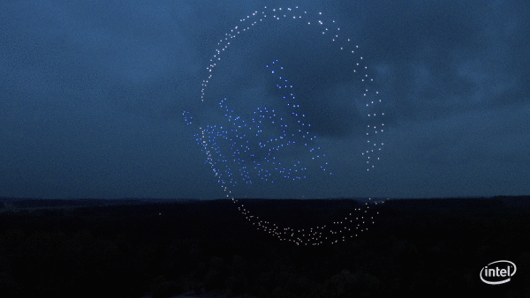

Slide 5
Model
2 Dimensional world (R²) with K=50 agents (birds, sensors) indexed by k and J=1 targets (moving food, signal) indexed by j
At every iteration i, each agent will have some estimates and measurements (noisy) about the world:
the distance (analogous to y from our homework) from each agent to each target:
d_{k} = d_{k}^{truth} + noise_{k}^{d} where d_{k}.shape = [1,1]
the processing (analogous to h from our homework) from each agent to each target:
u_{k} = u_{k}^{truth} + noise_{k}^{u} where u_{k}.shape = [2,1]
u_{k} = u_{k} / np.linalg.norm(u_{k})
u_{k}^{truth} = [np.cos(theta_{k}) , np.sin(theta_{k})].T
theta_{k} = np.arctan2((w_{j}^{truth}[1]-x_{j}[1]) , (w_{j}^{truth}[0]-x_{j}[0]))
w_{j}^{truth} is the location of target j where w_{j}^{truth}.shape = [2,1]
x_{k} is the location of agent k where x_{k}.shape = [2,1]
Additive noise term for distance is Gaussian w/ 0 mean and variance equal to the ratio of the distance from the agent to the target to the distance from the center of mass of the agents to the target (for direction, Gaussian w/ 0 mean and variance equal to sin(π/32) = 0.0980)

Slide 6
Model (continued)
Ultimately, we have the following linear relationship that relates the agent k’s estimate of the direction (regression vector) and its estimate of the distance (at each iteration i):
^d_{k} = d_{k} + (u_{k}.T @ x_{k})
^d_{k} = (u_{k}.T @ w_{j}^{truth}) - (noise_{k}^{u}.T @ (w_{j}^{truth} - x_{k})) + noise_{k}^{d}
Furthermore, each agent k estimates the location of each target j using the previously defined parameters (at each iteration i):
q_{k} = x_{k} + (d_{k} @ u_{k})
q_{k} = w_{j}^{truth} + (noise_{k}^{d} * u_{k}^{truth}) + (d_{k}^{truth} * noise_{k}^{u}) + (noise_{k}^{d} * noise_{k}^{u})
We then use the three derived parameters to update each agent’s velocity.

Slide 7
Model (continued)
The velocity should be a linear combination of the following rules:
1. Each agent should move towards a target
v_{k} ~ (w_{j}^{truth} - x_{k}) / np.linalg.norm(w_{j}^{truth} - x_{k})₂
Truth values will be replaced by estimates: w_{j}^{truth} is related to q_{k}
2. Each agent should avoid areas of high noise
Important rule but we will make the assumption that the R² world has uniform noise
This will not play a role in adjusting velocity
3. Each agent should move consistently with the group
all_bird_global_velocity = np.expand_dims((1 / K) * np.sum(bird_Velocities, axis=1), axis=1)
v_{k} ~ all_bird_global_velocity
This can also be estimated but the agents will be given the known value
4. (not that important) Agents should not collide or impede in the movement of other agents

Slide 8
Model (continued)
v_{k} = hunger * f(w_{j}^{estimated by k} - x_{k} , s) + consistency * all_bird_global_velocity + shyness * g({x_{k}} , r)
{hunger, consistency, shyness} are all non-negative weighting factors
f(w_{j}^{estimated by k} - x_{k} , s):
s is related to a upper-bound on the velocity
If np.linalg.norm(w_{j}^{estimated by k} - x_{k}) <= s:
f(w_{j}^{estimated by k} - x_{k} , s) = w_{j}^{estimated by k} - x_{k}
Else:
f(w_{j}^{estimated by k} - x_{k} , s) = s*(w_{j}^{estimated by k} - x_{k}) / np.linalg.norm(w_{j}^{estimated by k} - x_{k})
g({x_{k}} , r):
r is related to the safe distance agents would like to have amongst other agents
For all l in K not k, sum [(np.linalg.norm(x_{l}-x_{k})-r) * (x_{l}-x_{k}) / np.linalg.norm(x_{l}-x_{k})]

Slide 9
Logic
Define an init function that instantiates your K agents’ and J targets’ positions and velocities (note that the same function can be used for instantiating each of these)
bird_Positions.shape = (2 , K) = (2 , 50)
bird_Velocities.shape = (2 , K) = (2 , 50)
prey_Positions.shape = (2 , J) = (2 , 1)
prey_Velocities.shape = (2 , J) = (2 , 1)
Define update function that takes in the previous arrays of positions and velocities, performs some logic, and updates the velocities of each (will only focus on updating the velocity of the birds)
It helps to define boundary conditions or make world large and confine the location of the target.
Whenever the center of mass (defined as the average of all the positions of the birds) is within an area defined by a circle of the target, instantiate new prey_Positions.
all_bird_center_of_mass_location = np.expand_dims((1 / K) * np.sum(bird_Positions, axis=1), axis=1)

Slide 10
Logic (continued)
The update function holds all the logic to updating every iteration i:
1. Check boundary conditions
2. Calculate center of mass of birds
3. Instantiate lists to hold:
Estimate distances from each bird k to each prey j, DD
Estimate direction(processing) from each bird k to each prey j, UU
Estimate location of each prey j from each bird k, QQ
4. Iterate through all prey:
for j in range(prey_Positions.shape[1] = J):
4.1. Set w_{j}^{truth}
4.1. Check if center of mass of birds is on/near w_{j}^{truth}
If so, init(prey_Positions)

Slide 11
Logic (continued)
5. Iterate through all prey again:
for j in range(prey_Positions.shape[1] = J):
5.1. Get w_{j}^{truth}
5.2. Instantiate lists to hold:
Estimate distances from each bird k to prey j as D_{j} and noise as N_{j}
Estimate direction(processing) from each bird k to prey j as U_{j}
Estimate location of each prey j from each k as Q_{j}
5.3. Iterate through all birds:
for k in range(BOIDpositions.shape[1] = K):
5.3.1. Get x_{k}
5.3.2. Evaluate noise parameters and N_{j}.append( noise_variance )
5.3.3. D_{j}.append( ^d_{k} )
5.3.4. U_{j}.append( u_{k} )
5.3.5. Q_{j}.append( q_{k} )

Slide 12
Logic (continued)
5.4 Using D_{j}, N_{j}, U_{j}, and Q_{j}
DD.append( D_{j} )
UU.append( U_{j} )
QQ.append( Q_{j} )
Aside; recall linear model: D_{j} = U_{j} @ w_{j}^{truth}
Goal is then to then perform the following: min_{w} E[ ||D_{j} - U_{j} @ w_{j}||² ]
The solution to this are the normal equations: w_{j}^{estimated by k} = (U_{j}.T @ U_{j})⁻¹ @ (U_{j}.T @ D_{j})
The MSE is then defined as : ||w_{j}^{truth} - w_{j}^{estimated by k}||₂²
Rest of the algorithm is straightforward:
Update velocities using w_{j}^{estimated by k}
XXXX_Positions += XXXX_Velocities

Slide 13
Code
Changing the logic of the how we estimate and update our velocity will give us different results.
Present code.
Definition of algorithms can be found in
Chapter on Data Fusion in the Notes
Diffusion adaptation
https://www.researchgate.net/profile/Jinchao_Li3/publication/251994386_Honeybee_swarming_behavior_using_diffusion_adaptation/links/58c19ecd45851538eb7ce1bb/Honeybee-swarming-behavior-using-diffusion-adaptation.pdf
Mobile Adaptive Networks and Least Mean Squares
https://www.youtube.com/watch?v=XzmDU-QXXkw
https://www.youtube.com/watch?v=ow--wl8PkKk
https://en.wikipedia.org/wiki/Minimum_mean_square_error
This is the same as our notes but some of the notation is more concise.
Problem 2 from midterm also contributed a lot
Diffusion Least-Mean Squares Over Adaptive Networks: Formulation and Performance Analysis by Lopes and Sayed

Slide 14
Code
Data fusion notes from the chapter on Regression analysis
Mobile Adaptive Networks by Tu and Sayed
https://github.com/shak360/UCLA-ECE-210A-Learning--Final

